Slide 1











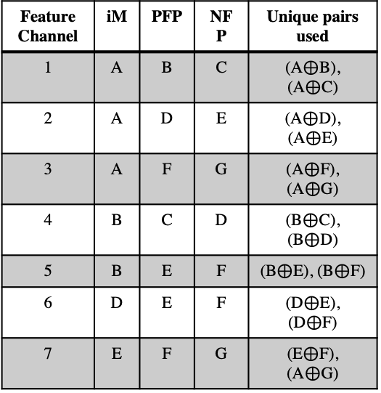
iM vectors constant per modality
FP constant per feature channel
Unoptimized
iM
FP
iM
FP
iM
FP
F_{1,i}
F_{1,j}
F_{1,j}
PFP₁
PFP₁
PFP₁
iM₁
NFP₁
SE_{1,j}
iM₁
NFP₁
SE_{1,j}
iM₁
NFP₁
$$⊕$$
SE_{1,j}
$$⊕$$
$$⊕$$
…
Modality 1
…
…
…
PFP_{m}
F_{m,j}
PFP_{m}
F_{m,j}
PFP₁
F_{m,i}
iM_{m}
NFP_{m}
SE_{m,j}
NFP_{m}
SE_{m,j}
iM_{m}
NFP₁
SE_{m,j}
$$⊕$$
iM_{m}
$$⊕$$
$$⊕$$
…
…
…
PFP_{n}
F_{n,j}
PFP_{n}
F_{n,j}
PFP_{n}
F_{n,i}
iM_{n}
NFP_{n}
SE_{n,j}
NFP_{n}
SE_{n,j}
NFP_{n}
$$⊕$$
SE_{n,j}
$$⊕$$
iM₁
$$⊕$$
iM₁
…
Modality m
…
…
…
PFP_{p}
F_{p,j}
PFP_{p}
F_{p,j}
PFP_{n}
F_{p,i}
iM_{p}
NFP_{p}
SE_{p,j}
NFP_{p}
SE_{p,j}
iM_{m}
NFP_{n}
SE_{p,j}
$$⊕$$
iM_{m}
$$⊕$$
$$⊕$$
Stored
Vectors
Feature Channel | iM | PFP | NFP | Unique pairs used
1 | A | B | C | (A$⊕$B), (A$⊕$C)
2 | A | D | E | (A$⊕$D), (A$⊕$E)
3 | A | F | G | (A$⊕$F), (A$⊕$G)
4 | B | C | D | (B$⊕$C), (B$⊕$D)
5 | B | E | F | (B$⊕$E), (B$⊕$F)
6 | D | E | F | (D$⊕$E), (D$⊕$F)
7 | E | F | G | (E$⊕$F), (A$⊕$G)
A B
C D
E F
G

Slide 2
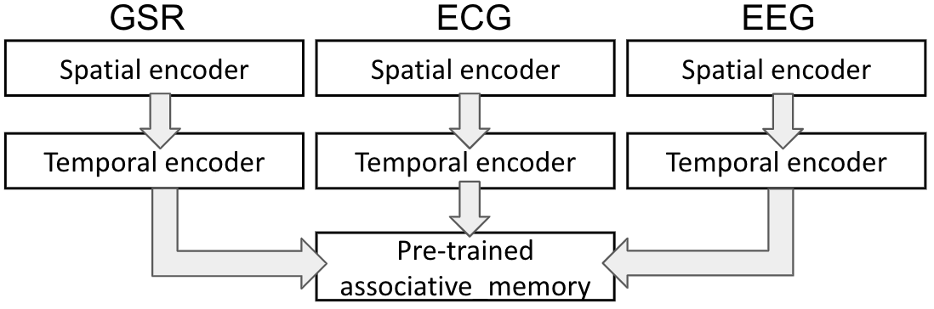
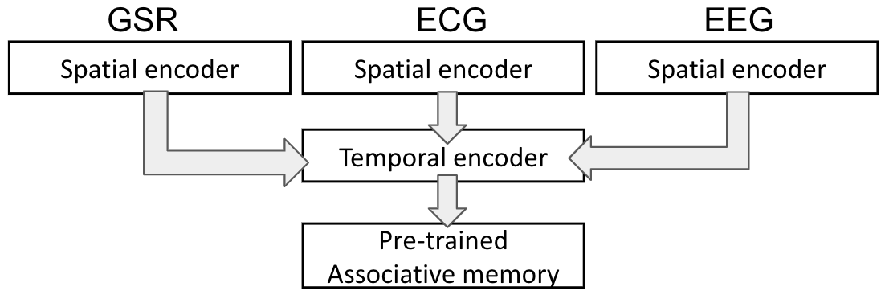



$ρ$⁻¹
Rule 90
$$⊕$$
HV_{n}
HV_{n+1}
$ρ$⁺¹
Spatial Encoder
Spatial Encoder
Spatial Encoder
Temporal Encoder
Temporal Encoder
Temporal Encoder
Fusion
Associative Memory
(a)
(a) Late fusion
Spatial Encoder
Spatial Encoder
Spatial Encoder
Fusion
Temporal Encoder
(b) Early fusion
Associative Memory
(b)

Slide 3











Features from modality 1
: HD vector
[+]
: bundling
$ρ$^{n}
: permutation
$⊕$: binding
: Signal
F_{1,j}
HDC Early Fusion Architecture
…
PFP₁
>0
NFP₁
<=0
$$⊕$$
SE_{1,j}
iM₁
F_{m,j}
…
[+]
Training/inference
PFP_{m}
>0
NFP_{m}
<=0
SE_{m,j}
…
iM_{m}
$$⊕$$
Trained vectors
Features from modality m
…
[+]
SE_{j}
$ρ$⁰
$$⊕$$
TE_{j}
Inferred labels
F_{n,j}
Hamming distance
…
PFP_{n}
>0
$ρ$¹
NFP_{n}
<=0
SE_{n,j}
…
iM_{n}
$$⊕$$
F_{p,j}
…
[+]
$$∗ = n−1$$
PFP_{p}
>0
$ρ$*
NFP_{p}
<=0
SE_{p,j}
iM_{p}
$$⊕$$
Spatial Encoder
Fusion
Temporal Encoder
Associative Memory

Slide 4
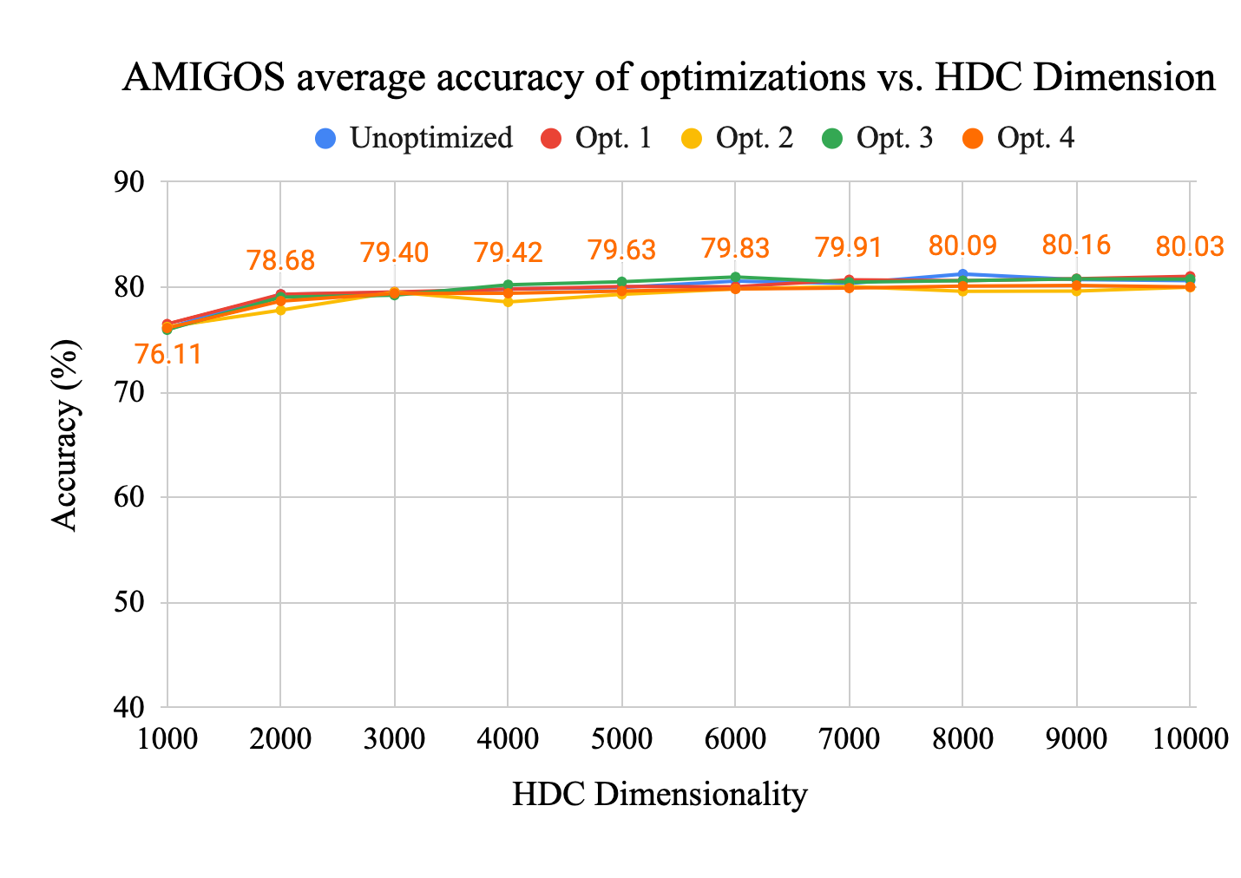
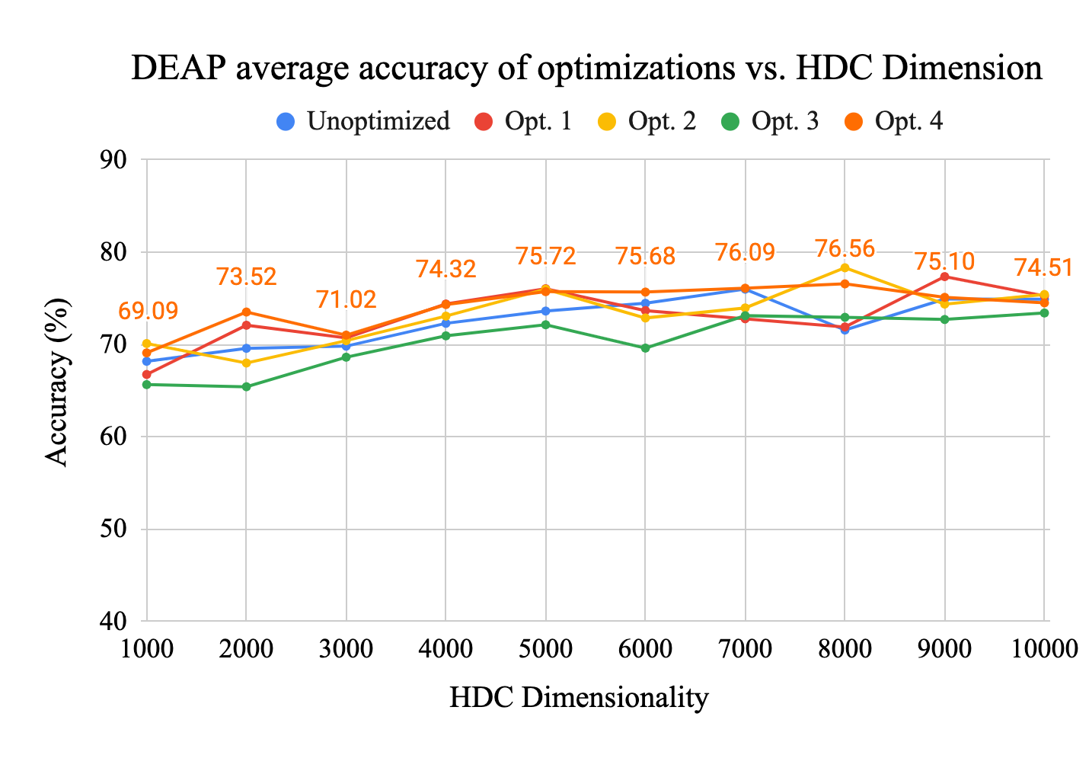
(a)
(b)

Slide 5
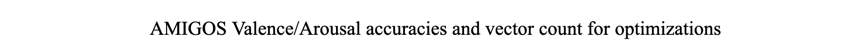


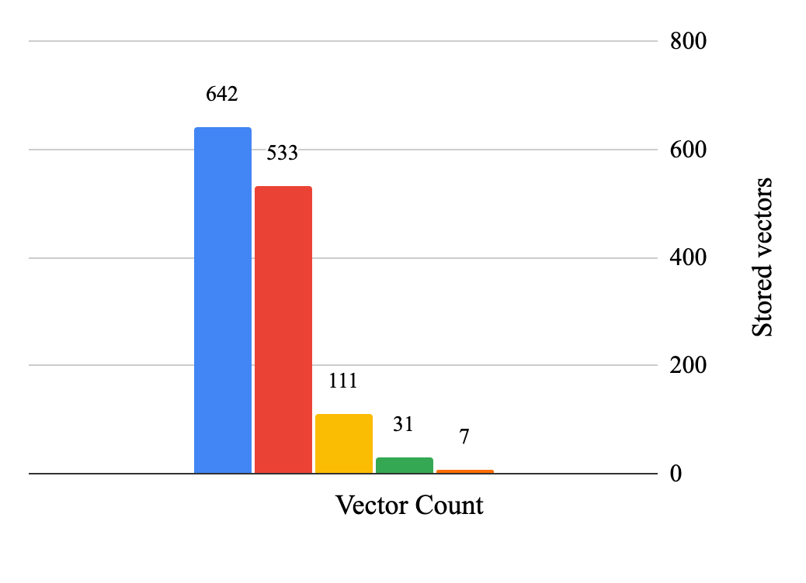
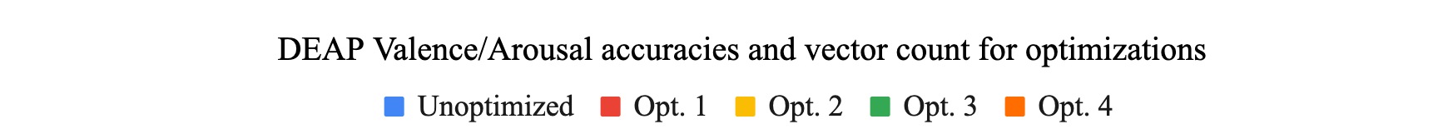
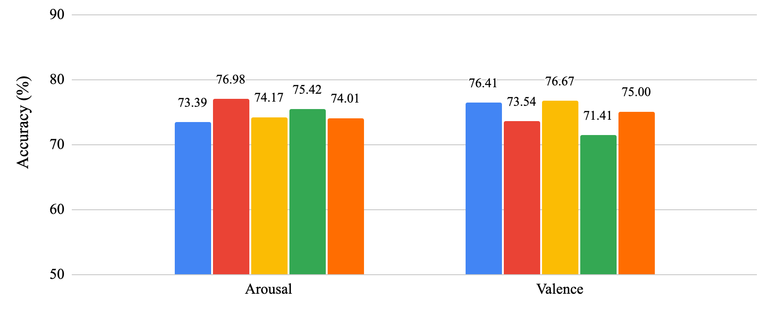
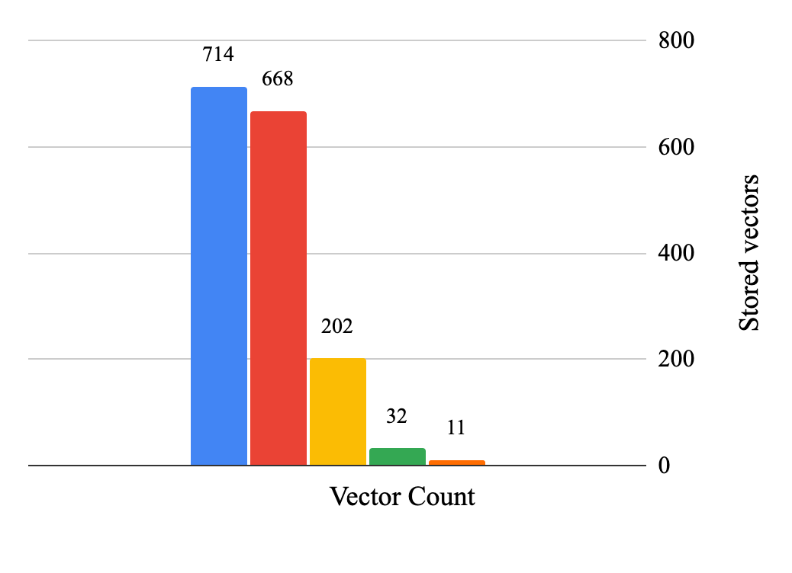
(a)
(b)

Slide 6
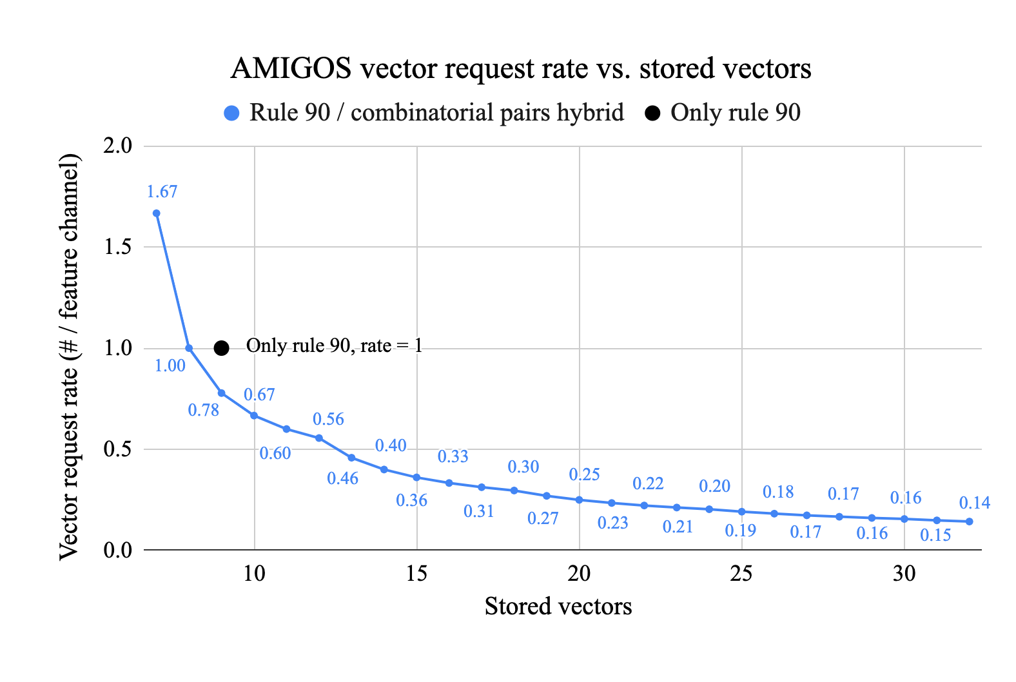
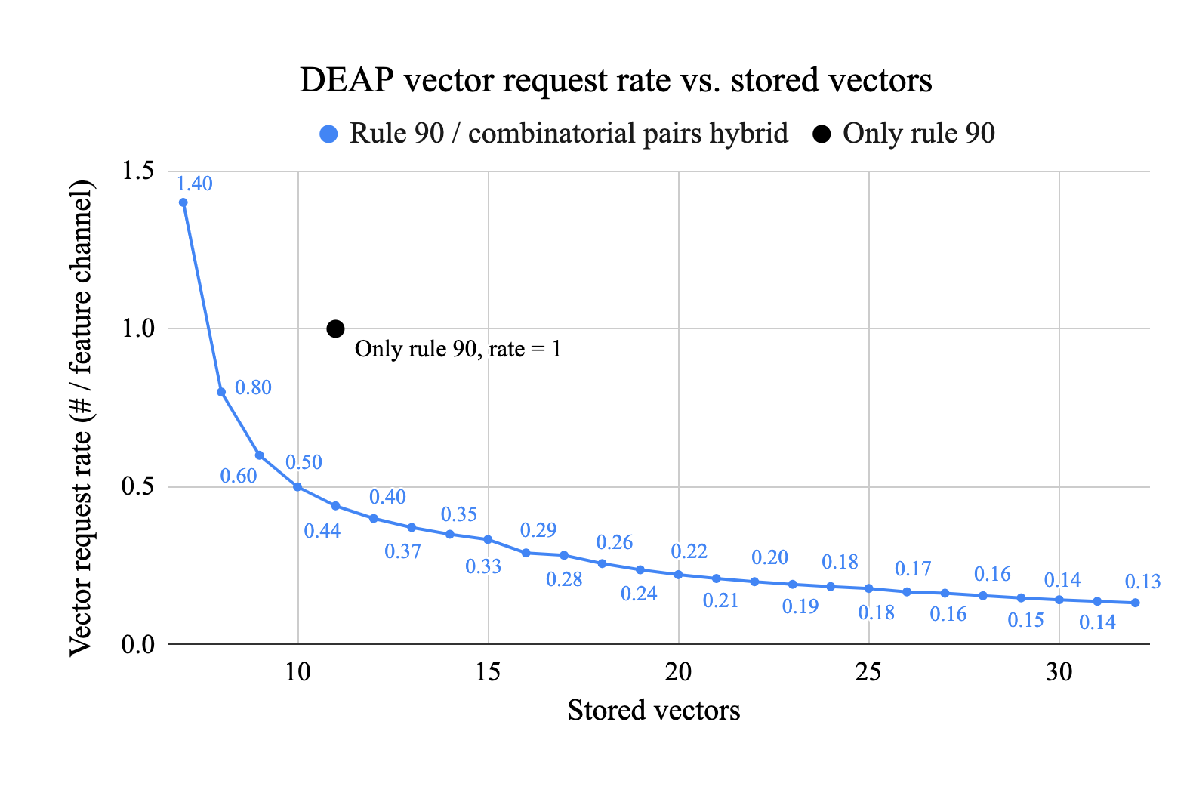
(a)
(b)

Slide 7
